Slide 1
_{Ch. 1 Introduction}
What is Data Mining?
Recently coined term for confluence of ideas from statistics and computer science (machine learning and database methods) applied to large databases in science, engineering and business.
Extracting or “mining” knowledge from large amount of data
Autonomously retrieving useful information or knowledge (“actionable assets”) from large data stores
The nontrivial extraction of implicit, previously unknown, and potentially useful information from data. Frawley, Piatetsky-Shapiro, and Matheus (1992)
Knowledge discovery from data (KDD)

Slide 2
_{Introduction}
Data mining—core of knowledge discovery process
Knowledge
Pattern Evaluation
Data Mining
Task-relevant Data
Data Warehouse
Selection
Data Cleaning
Data Integration
Fig. Knowledge Discovery Process
Databases

Slide 3
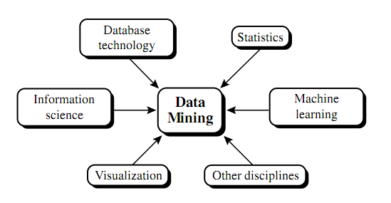
_{Introduction}
Fig. Data Mining as confluence of multiple discipline

Slide 4
_{Classification of data mining}
According to kinds of databases mined:
Data models : relational, transactional, object-relational, or data warehouse mining
Special types of data handled : spatial, time-series, text, stream data, multimedia or web mining
According to kinds of knowledge mined:
Data Mining functionalities : classification, prediction, clustering, outlier analysis
Levels of abstraction of the knowledge : high level, primitive-level ( at a raw data level), and multiple levels of abstraction
Regularities Vs irregularities : common patterns, exceptions or outliers

Slide 5
_{Classification of data mining}
According to kinds of techniques utilized:
Degree of user interaction : interactive exploratory systems, query-driven systems
Methods of data analysis : machine learning, statistics, visualization, pattern recognition
According to application adapted:
Analysis of finance, telecommunications, DNA, stock markets, e-mail, and so on
In general, different applications often require the integration of application-specific methods

Slide 6
_{Major Issues and Challenges}
Mining methodology and user interaction issues:
Mining different kinds of knowledge in databases: To mine different kinds of knowledge, wide spectrum of data analysis and knowledge discovery should be covered. Same database in different ways and require the development of numerous data mining techniques.
Interactive mining of knowledge at multiple levels of abstraction: It is difficult to know exactly what can be discovered within a database, the data mining process should be interactive. Interactive mining allows users to focus the search for patterns, providing and refining data mining requests based on returned results.
Incorporation of background knowledge: Domain knowledge related to databases, such as integrity constraints and deduction rules, can help focus and speed up a data mining process or judge the interestingness of discovered patterns.
Data mining query languages and ad hoc data mining: SQL and high-level data mining query language need to be developed to allow users to describe ad hoc data mining tasks. Such language should be integrated with a database or data warehouse query language and optimized for efficient and flexible data mining.

Slide 7
_{Major Issues and Challenges}
Mining methodology and user interaction issues(contd..):
Presentation and visualization of data mining results: Results should be presented in terms of trees, tables, charts, graphs, matrices or curves.
Handling noisy or incomplete data: Data cleaning and data analysis methods are required to handle noisy and incomplete data so that accuracy of the discovered patterns can be improved.
Pattern evaluation- the interestingness problem: Interesting patterns should be selected from the uncover thousands of patterns.
Performance issues:
Efficiency and scalability of data mining algorithms: Running time of a data mining algorithm must be predictable and acceptable in large database.
Parallel, distributed and incremental mining algorithms: Data are divided into partitions, which are processed in paralleled. The results from the partitions are then merged to reduced computational complexity. Incremental mining algorithm helps to update database without having to mine the entire data again “from scratch”.

Slide 8
_{Major Issues and Challenges}
Diversity of data base type:
Handling of relational and complex types of data: Due to diversity of data like complex data objects, hypertext, multimedia data, spatial data, transaction data, it is unrealistic to expect one system to mine all kinds of data. Specific data mining systems should be constructed for mining specific kinds of data.
Mining information from heterogeneous databases and global information systems: Local- and wide-area computer networks (such as the Internet) connect many sources of data, forming huge, distributed, and heterogeneous databases. The discovery of knowledge from different sources of structured, semi structured, or unstructured data with diverse data semantics poses great challenges to data mining. E.g. web mining-web contents, web structures, and web dynamics.

Slide 9
_{Data Mining Application}
Financial analysis
Loan payment and customer credit policy analysis
Classification and clustering of customers for targeted marketing
Detection of money laundering and other financial crimes
Retail Industry
Multidimensional analysis of sales, customers, products, time, and region
Analysis of the effectiveness of sales campaigns
Customer retention—analysis of customer loyalty
Product recommendation and cross-referencing of items

Slide 10
_{Data Mining Application}
Telecom Industry
Multidimensional analysis of telecommunication data
Fraudulent pattern analysis and the identification of unusual patterns
Multidimensional association and sequential pattern analysis
Mobile telecommunication services
Use of visualization tools in telecommunication data analysis
Biomedical Data Analysis
Analysis of different kinds of patterns e.g. DNA or other
And many more…..

